Slide 1
1
Low Level Design
Amazon Food Sales Data Analysis
Revision Number: 1.0
Last date of revision: 19/12/2023
Sourav Kumar Panigrahi

Slide 2
2
Document Version Control
Date Issued
Version
Description
Author
19 Dec 2023
1.0
First Version of Complete LLD
Sourav Kumar Panigrahi

Slide 3
3
Contents
1. Introduction .............................................................................................................................................. 4
1.1 What is Low-Level design document?................................................................................................. 4
1.2 Scope ................................................................................................................................................... 4
2. Architecture .............................................................................................................................................. 5
1. Data Sources ......................................................................................................................................... 5
2. Power BI Desktop .................................................................................................................................. 6
3. Power BI Service.................................................................................................................................... 6
4. Power BI Report Server ......................................................................................................................... 6
5. Power BI Gateway ................................................................................................................................. 6
6. Power BI Mobile.................................................................................................................................... 6
7. Power BI Embedded.............................................................................................................................. 6
3. ARCHITECTURE DESCRIPTION ................................................................................................................... 7
3.1 Data Description.................................................................................................................................. 7
3.2 Data Loading ....................................................................................................................................... 7
3.3 Data Transformation ........................................................................................................................... 8
3.3 Data Modelling.................................................................................................................................... 8
3.4 DEPLOYMENT: ..................................................................................................................................... 9
4. UNIT TEST CASES ..................................................................................................................................... 10

Slide 4
4
1. Introduction
1.1 What is Low-Level design document?
The goal of the LDD or Low-level design document (LLDD) is to give the internal logic design of the actual program code for the House Price Prediction dashboard. LDD describes the class diagrams with the methods and relations between classes and programs specs. It describes the modules so that the programmer can directly code the program from the document.
1.2 Scope
Low-level design (LLD) is a component-level design process that follows a step-by-step refinement process. The process can be used for designing data structures, required software architecture, source code and ultimately, performance algorithms. Overall, the data organization may be defined during requirement analysis and then refined during data design work.

Slide 5
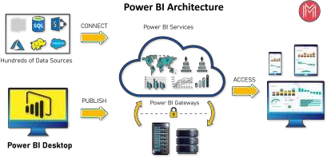
5
2. Architecture
Power BI is a business suite that includes several technologies that work together. To deliver outstanding business intelligence solutions, Microsoft Power BI technology consists of a group of components such as:
•
•
•
•
•
•
•
Power Query (for data mash-up and transformation)
Power BI Desktop (a companion development tool) Power BI Mobile (for Android, iOS, Windows phones) Power Pivot (for in-memory tabular data modeling) Power View (for viewing data visualizations)
Power Map (for visualizing 3D geo-spatial data) Power Q&A (for natural language Q&A)
1. Data Sources
An important component of Power BI is its vast range of data sources. You can import data from files in your system, cloud-based online data sources or connect directly to live connections. If you import from data on-premise or online services there is a limit of 1 GB. Some commonly used data sources in Power BI are:
•
•
•
•
•
•
•
•
•
•
•
•
•
Excel
Text/CSV XML
JSON
Oracle Database IBM DB2 Database MySQL Database PostgreSQL Database Sybase Database Teradata Database SAP HANA Database
SAP Business Warehouse server
Amazon Redshift

Slide 6
6
•
•
•
•
•
•
•
Impala
Google BigQuery (Beta) Azure SQL Database Salesforce Reports Google Analytics Facebook
GitHub
2. Power BI Desktop
Power BI Desktop is a client-side tool known as a companion development and authoring tool. This desktop-based software is loaded with tools and functionalities to connect to data sources, transform data, data modeling and creating reports.
3. Power BI Service
Power BI Service is a web-based platform from where you can share reports made on Power BI Desktop, collaborate with other users, and create dashboards.
It is available in three versions:
•
•
•
Free version
Pro version
Premium version
Power BI Service is also known as, “Power BI.com”, “Power BI Workspace”, “Power BI Site” and “Power
BI Web Portal”. This component also offers advanced features like natural language Q&A and alerts.
4. Power BI Report Server
The Power BI Report Server is similar to the Power BI Service. The only difference between these two is that Power BI Report Server is an on-premise platform. It is used by organizations who do not want to publish their reports on the cloud and are concerned about the security of their data.
Power BI Report Server enables you to create dashboards and share your reports with other users following proper security protocols. To use this service, you need to have a Power BI Premium license.
5. Power BI Gateway
This component is used to connect and access on-premise data in secured networks. Power BI Gateways are generally used in organizations where data is kept in security and watch. Gateways help to
extract out such data through secure channels to Power BI platforms for analysis and reporting.
6. Power BI Mobile
Power BI Mobile is a native Power BI application that runs on iOS, Android, and Windows mobile devices. For viewing reports and dashboards, these applications are used.
7. Power BI Embedded
Power BI Embedded offers APIs which are used to embed visuals into custom applications.

Slide 7
7
3. ARCHITECTURE DESCRIPTION
3.1 Data Description
The dataset contains two tables Customer and Sales data of Amazon for the year 2017,2018,2019
Amazon Sales Data Features
1.
2.
3.
Custkey – It is a Unique Id used to define a customer.
Datekey – It is the date on which transaction took place.
Discount amount – It is the difference between Sales amount based on list price and Sales amount.
Invoice Date – It is the date on Which the Ordered delivered and invoice created.
Invoice Number – It is a Unique number generated by the system after making of invoice
Item Class – It is the class of the Item.
Item Number – It is a Unique number used to define an item.
Item – It is the name of the item for which transaction took place. Line Number – It is the number of line from which it is ordered.
4.
5.
6.
7.
8.
9.
10. List Price – It is the price quoted by the manufacturer.
11. Order Number – It is the Unique Number for the particular order.
12. Promised delivery date – It is the date provided on which delivery is expected.
13. Sales Amount – It is the Product of Sales Price and Quantity.
14. Sales amount based on List Price – It is the product of List price and Quantity.
15. Sales Cost amount – It is the amount caused for making sales of the item.
16. Sales Margin amount - It is the difference between Sales amount and Sales cost amount.
17. Sales Price – It is the price at which Item is Sold.
18. Sales Quantity – It is the quantity of the ordered item.
19. Sales Rep. – It is the unique number or Id of the sales representative.
20. U/M – It Is the Unit of measurement for particular item.
Customer Details Data Features
1.
2.
3.
4.
5.
6.
7.
Custkey – It is a Unique Id used to define a customer.
Region Name – for eg central, southern etc. Division Name – Domestic or international City – Name of city
Country – Name of country
Zip Code – zip code for city.
Customer Name – It is a Customer name
3.2 Data Loading

Slide 8
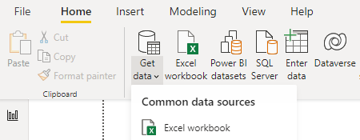
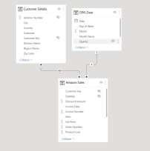
8
Step 1:- Open Power BI Desktop Application
Step 2:- Click on Get Data → Click on excel
Step 3:- Browse to the data file on your system and select
Step 4:- Once Data is loaded click on Transform data in the bottom for further transformation.
3.3 Data Transformation
In the Transformation Process, we will convert our original datasets with other necessary
attributes format and change the features according to the problem statement on Power BI ETL tool
Power Query as the data is in excel format.
A new Dim_ date table created for easy time intelligence analysis the features are:
1. Day of Week
2. Month name
3.Year
4. Year quarter
5. Month
6. Date
3.3 Data Modelling
After the data is transformed the data is modeled for visualizing and analysis.

Slide 9
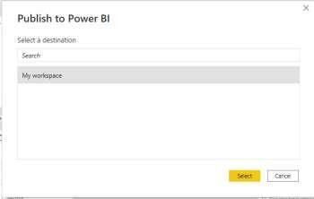
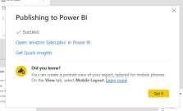
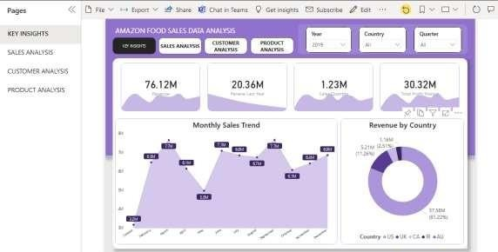
9
3.4 DEPLOYMENT:
After completing Dashboard Follow the Steps to deploy the report
Step 1:- Click on Publish on the ribbon.
Step 2:- A box will pop just click on my workplace and select
Step 3:- Now your report is published just click on open to check your report.
Step 4:- Report is published now explore your report

Slide 10
10
4. UNIT TEST CASES
Test Case Description
Slicer of Year, Country & Quarter
Slicer shows a drop down
Top 20 product slicer
Slicer show top 20 product and select works
Charts
All charts showing 0 error
Tooltips
Tooltips on various page working properly
Page buttons
Page buttons working properly

